Slide 1
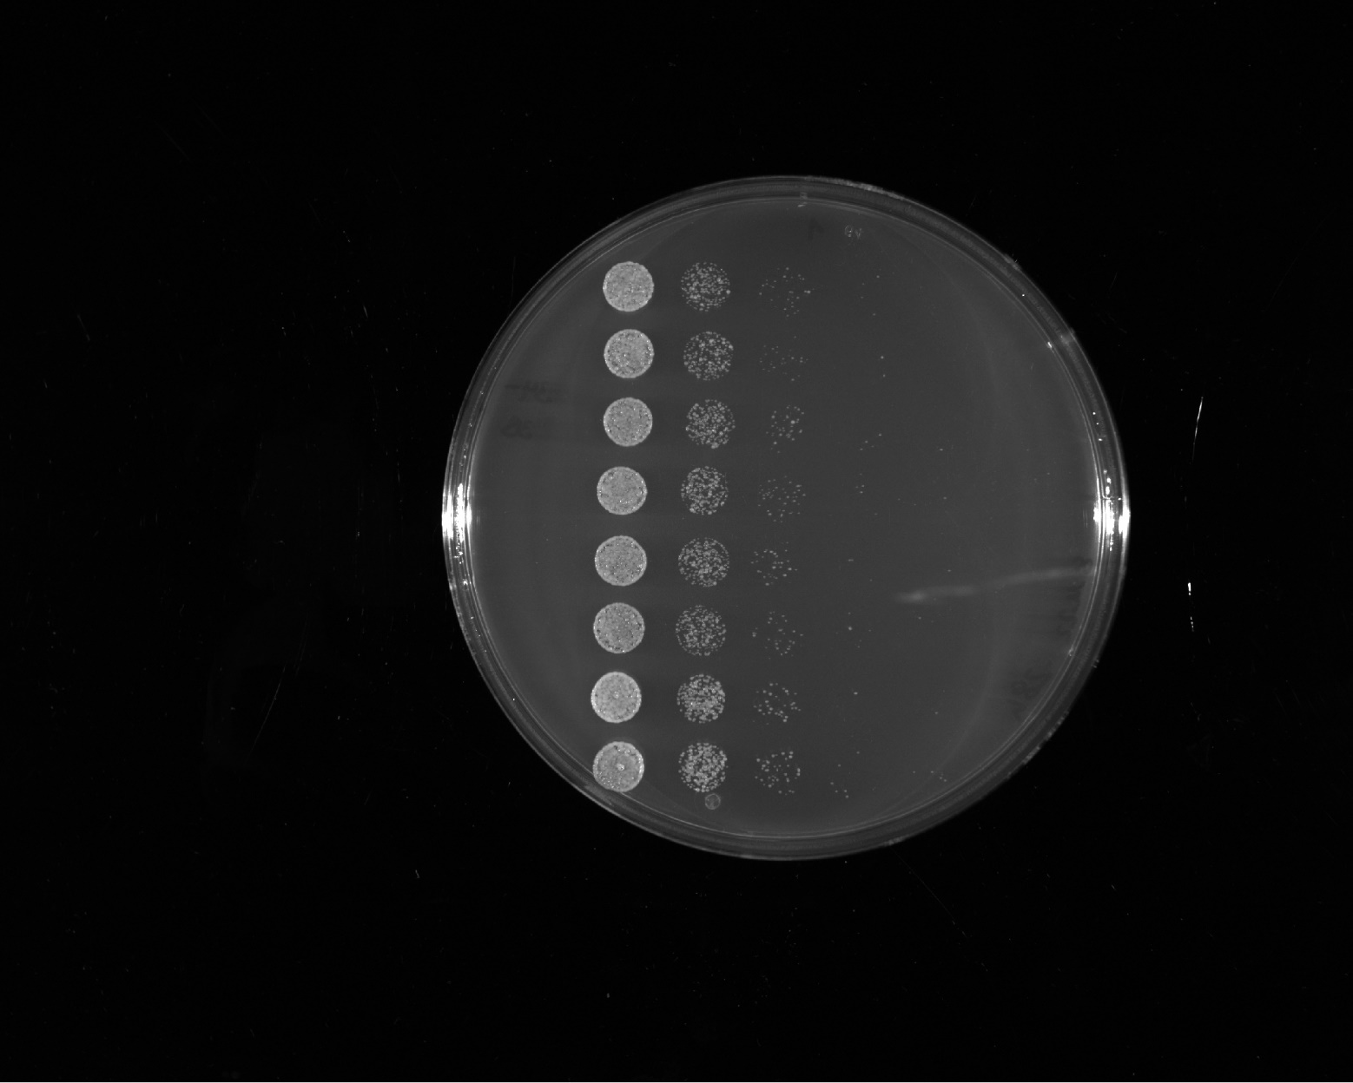
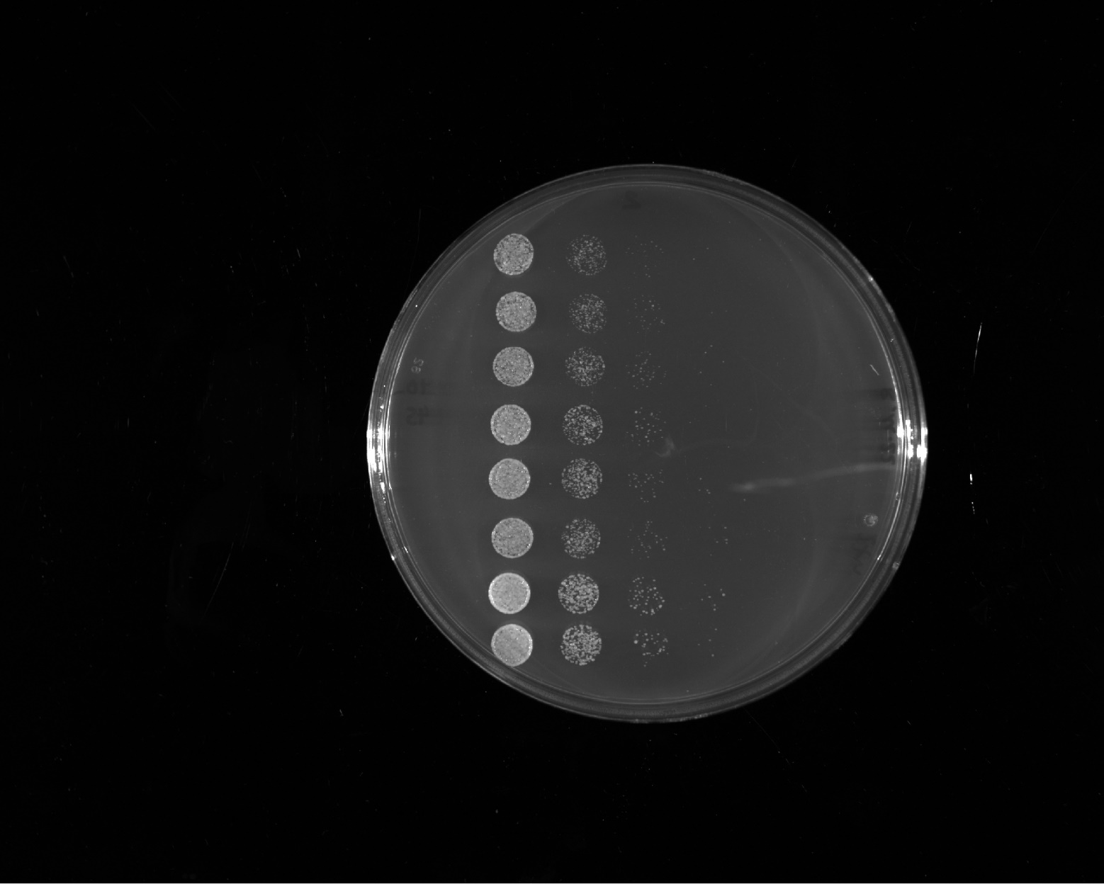
fig. S2
Unless noted otherwise, the following images show YPDA plates that were incubated for ca. 1 day at 30 °C. All strains carried the indicated Abf1 constructs on pRS315, while the chromosomal ABF1 gene was deleted. If one of the three independent clones after transformation for each construct did not show the same growth rate as the others, it is labeled as „outlier“ and we categorized the growth rate according to the two similarily growing clones. All rating is relative to the growth of the strain with wild type (WT) Abf1 on the same plate.
growth rate score
++++
FUS¹⁻¹⁶³12E + GR
++++
FUS¹⁻¹⁶³12E + Gal4^{M2}
++++
Abf1 WT
++++
FUS¹⁻¹⁶³12E + VP16
++++
FUS¹⁻¹⁶³12E + Gcn4
++++
Abf1 WT

Slide 2
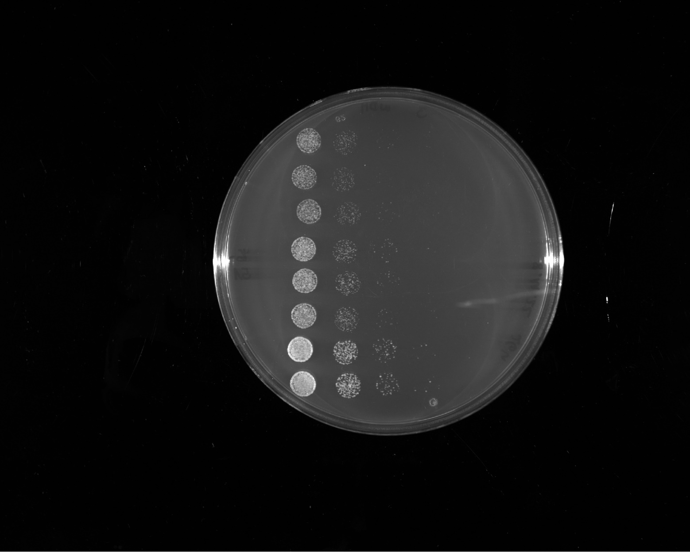
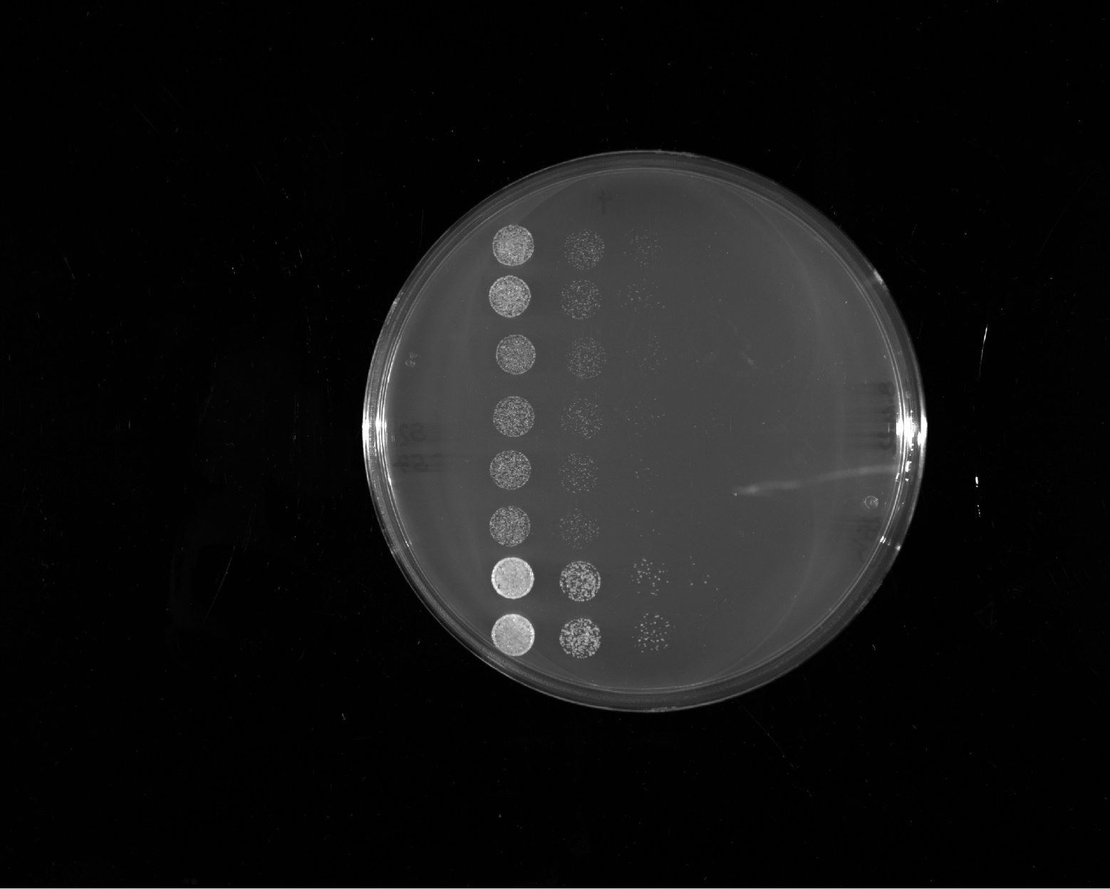
growth rate score
Abf1 IDR1⁸⁷⁻³¹¹ + Gal4^{G4}
++
+++
Rap1²³¹⁻³⁶¹ + Gal4^{G4}
++++
Abf1 WT
+++
LS-8
outlier
++
Sup35¹⁻¹³¹ + Gal4^{G4}
++++
Abf1 WT

Slide 3
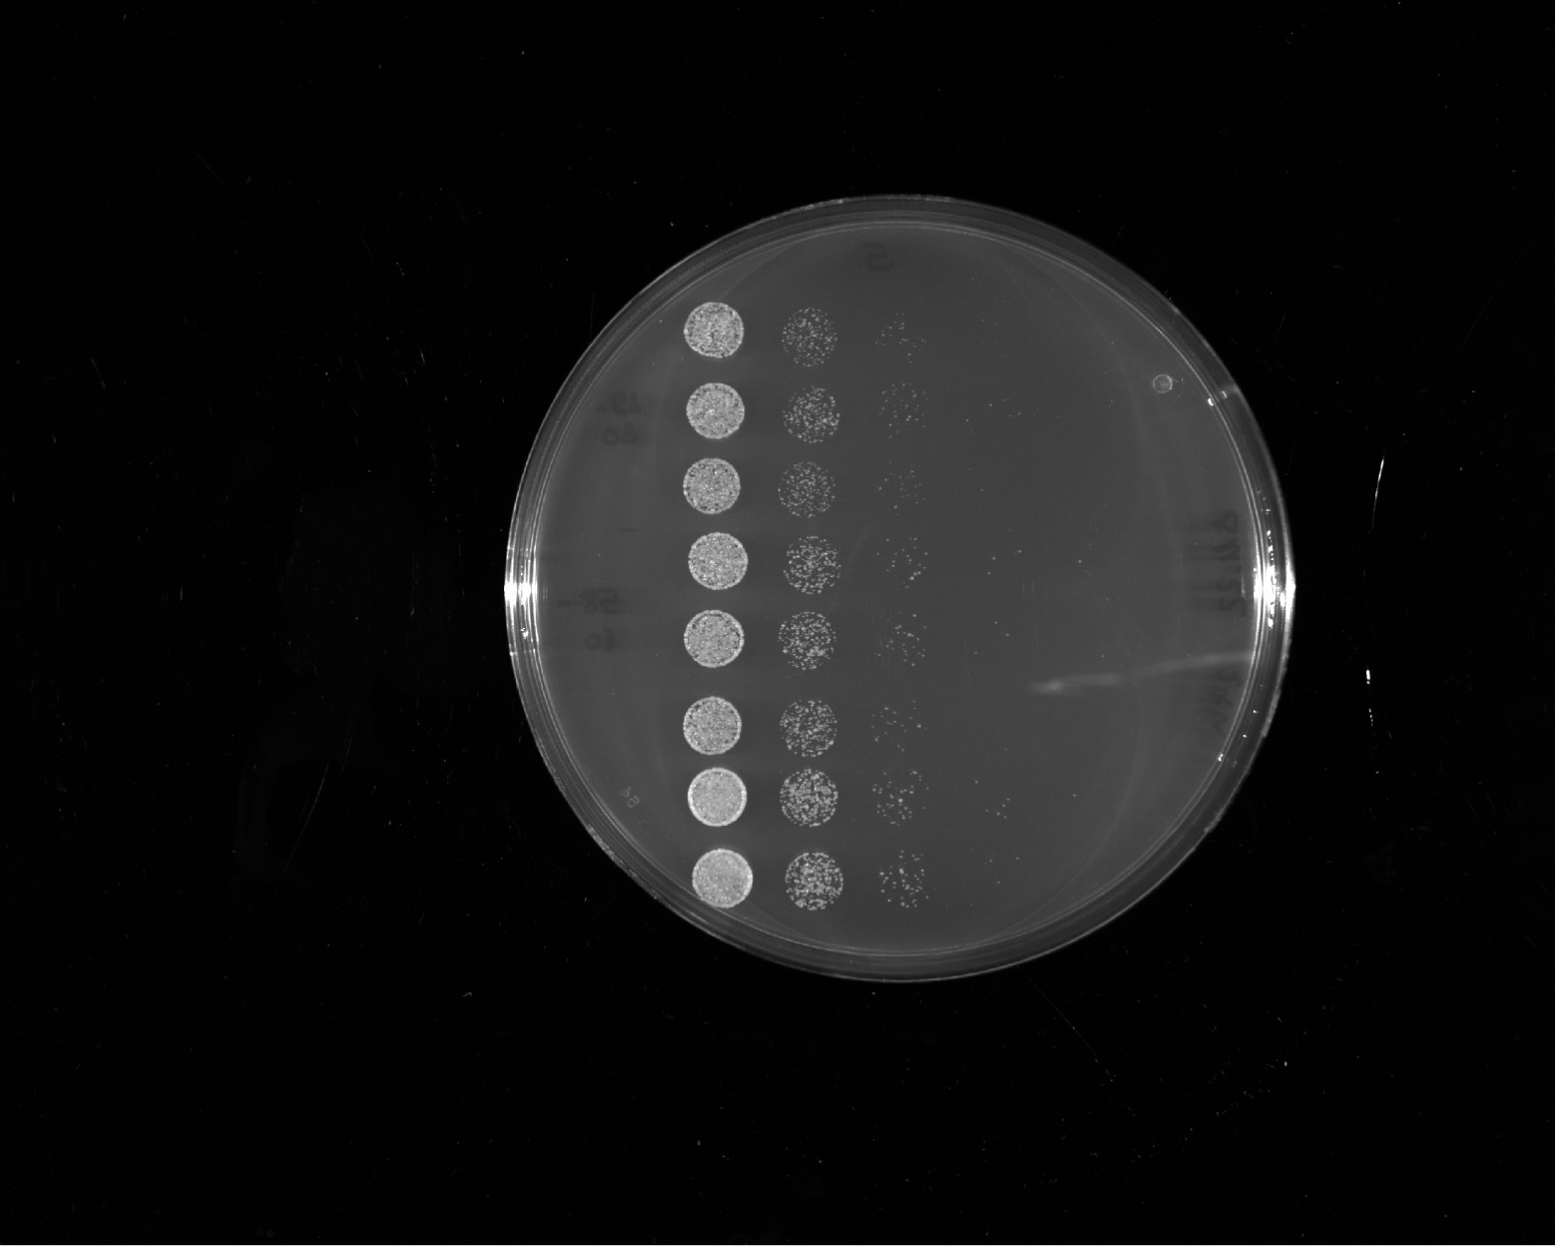
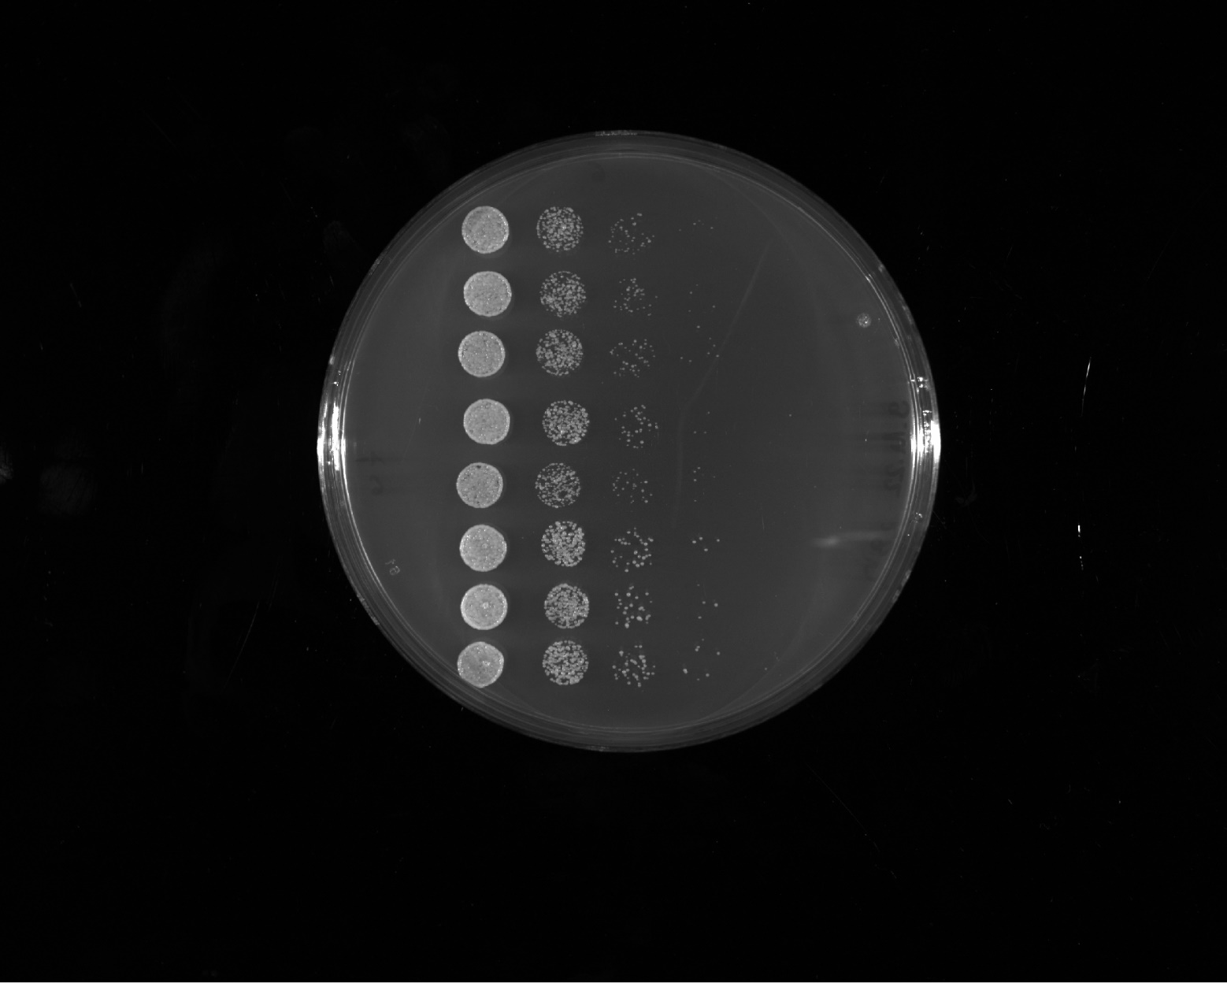
growth rate score
++++
FUS¹⁻¹⁶³12E + Gal4^{G4} distr.
++++
T. phaffii
++++
Abf1 WT
++++
LS-2
++++
LS-3
++++
Abf1 WT

Slide 4
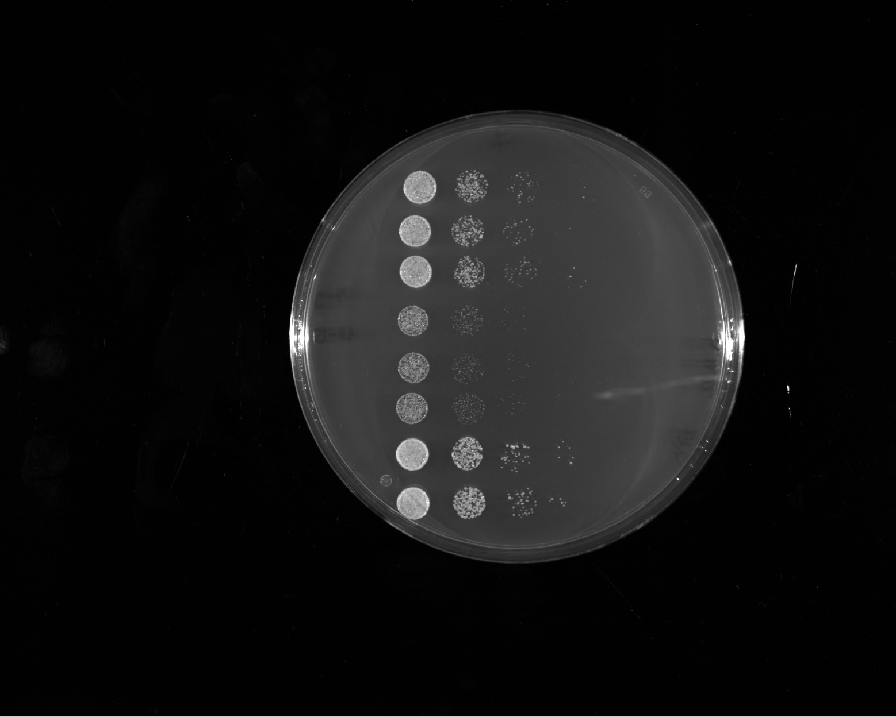
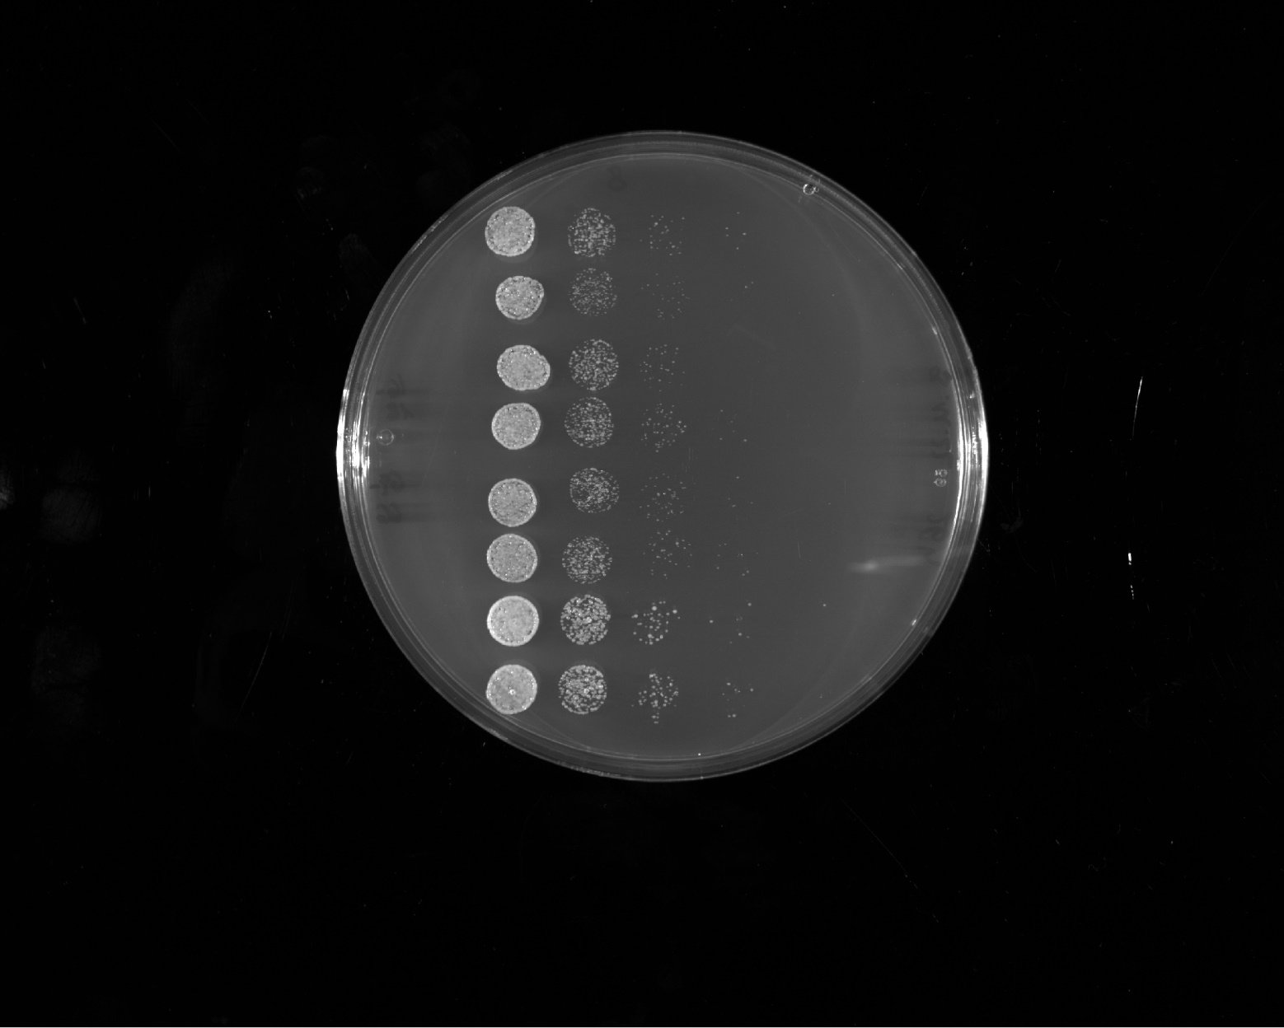
growth rate score
++++
LS-9
++
LS-13
++++
Abf1 WT
++++
LS-14
++++
Reb1¹⁻¹²⁰ ^{(PKEEEEGGL)}
++++
Abf1 WT

Slide 5
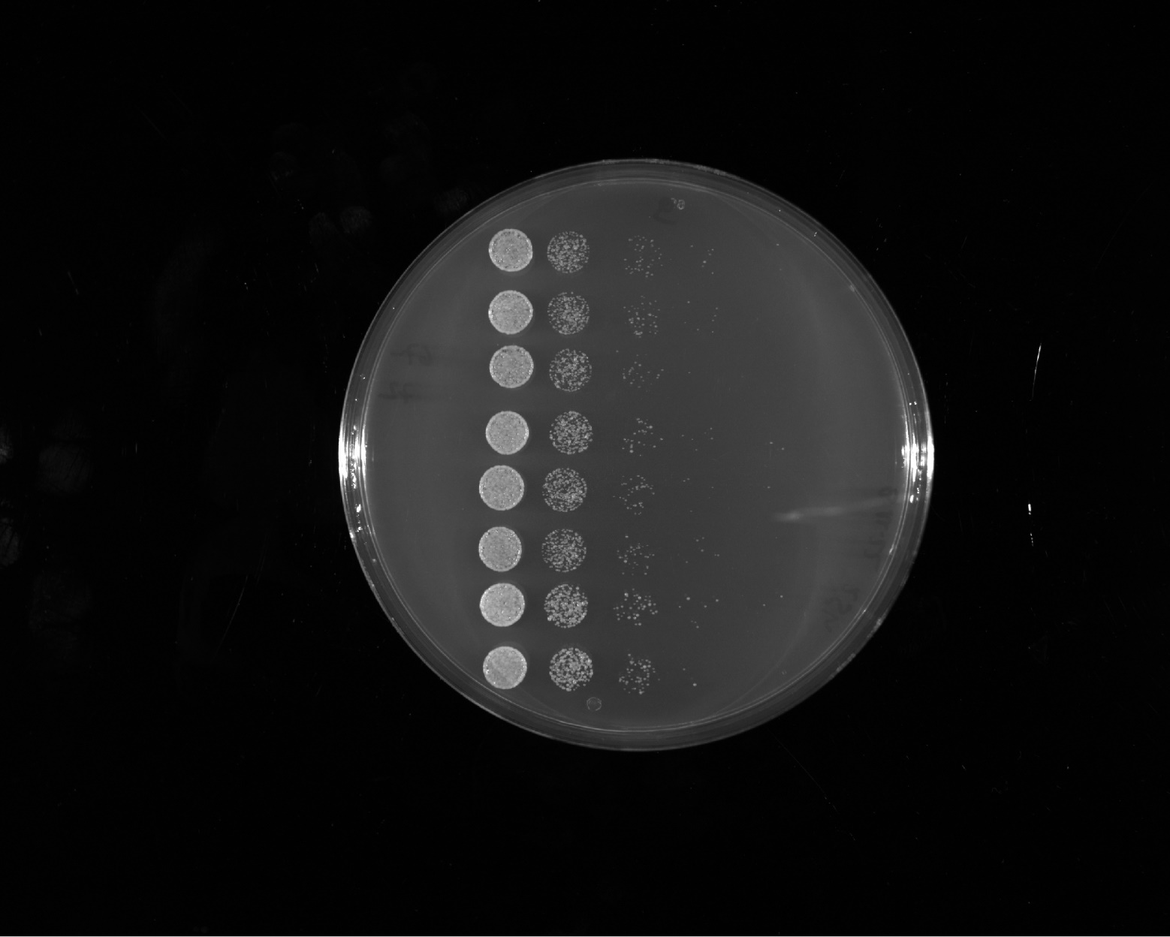
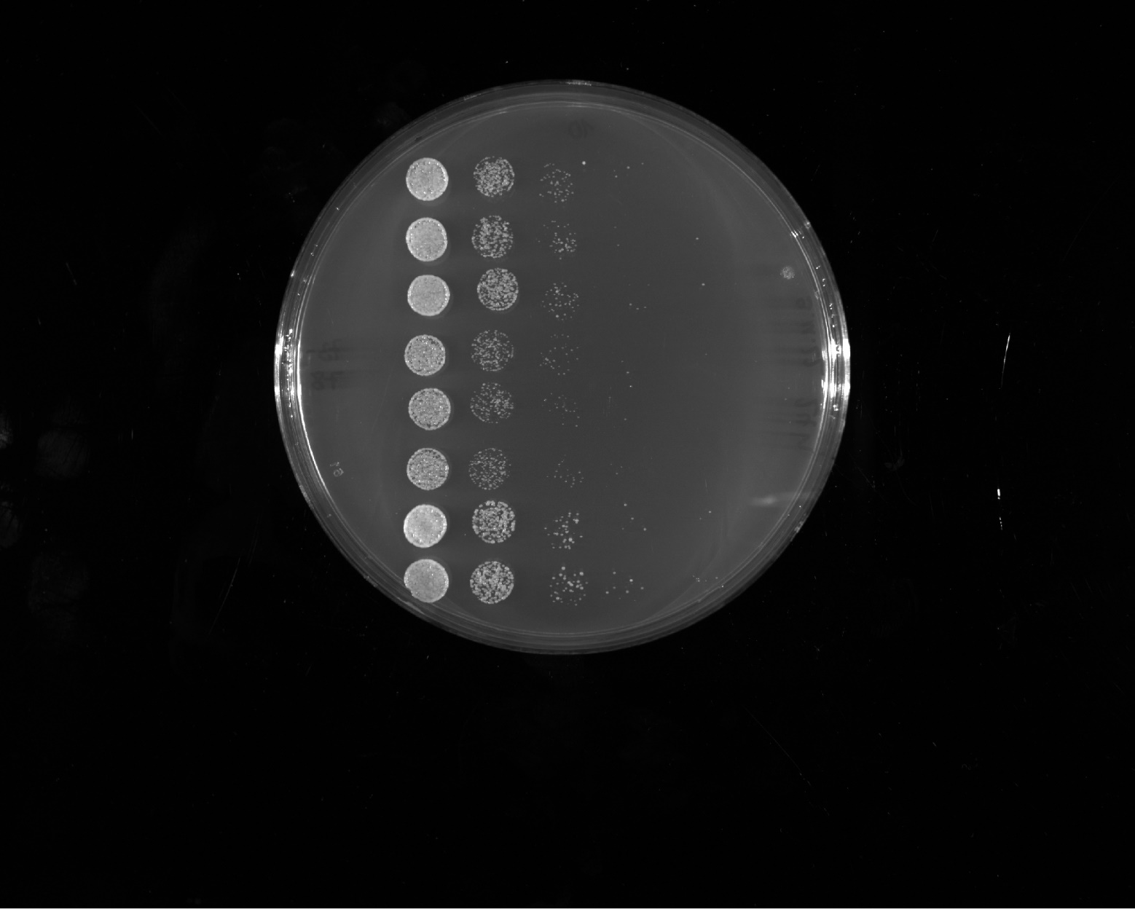
growth rate score
++++
S. kudriavzevii
++++
S. mikatae
++++
Abf1 WT
++++
S. uvarum
+++
T. delbrueckii
++++
Abf1 WT

Slide 6
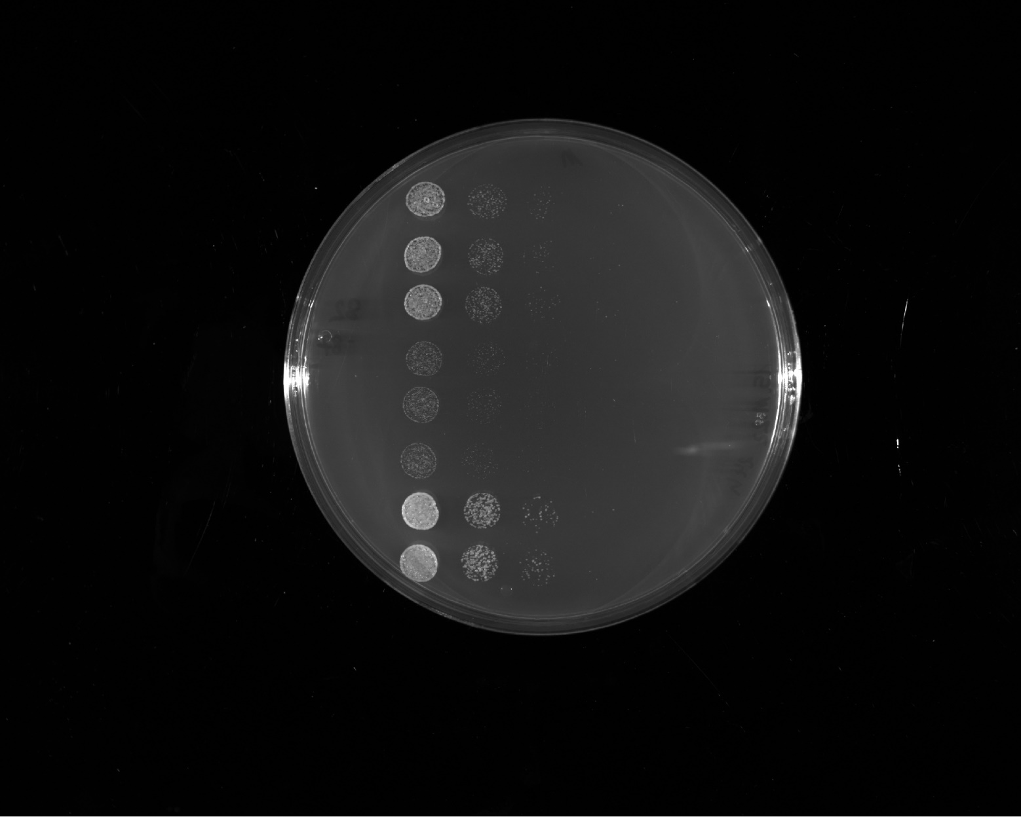
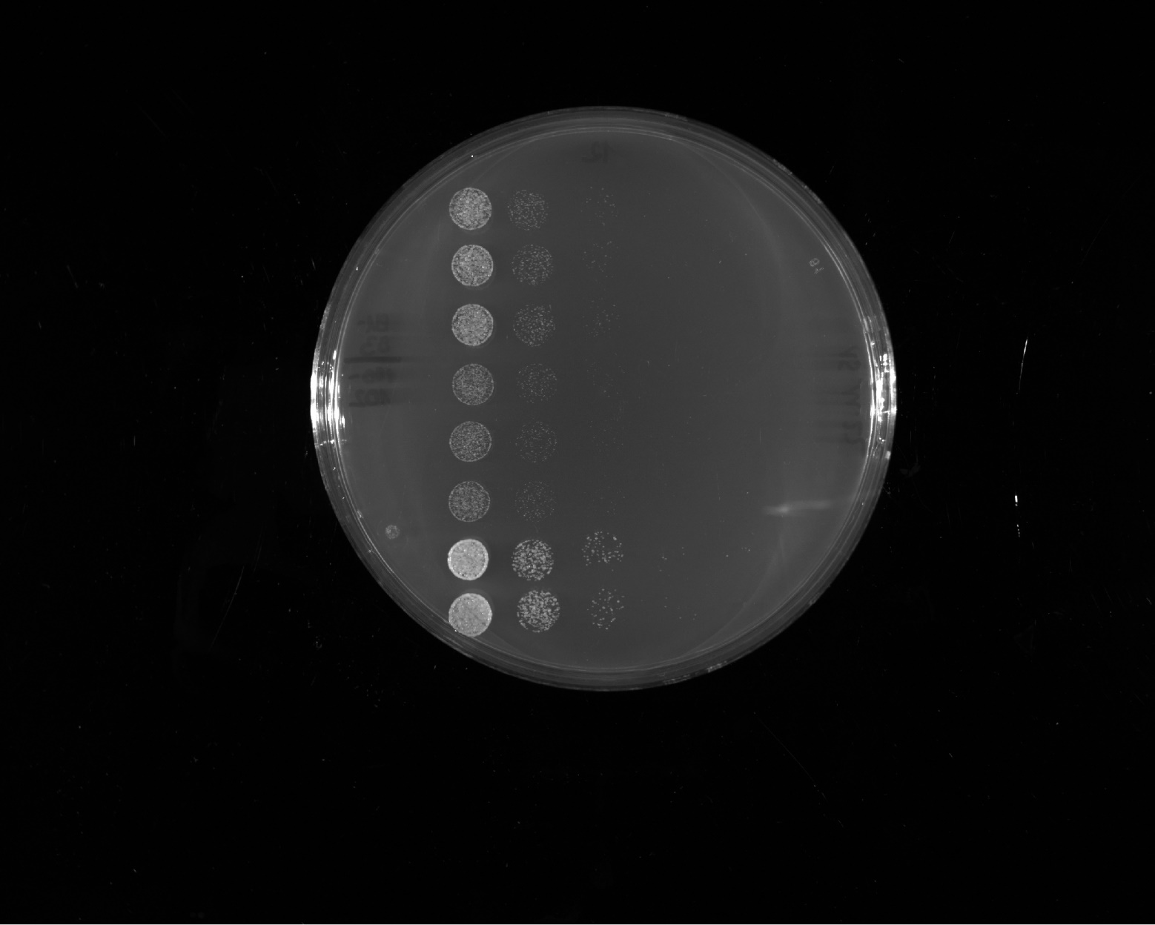
growth rate score
+++
FUS¹⁻¹⁶³12E + p65
++
FUS¹⁻¹⁶³12E + Gal4^{G4} aromatic clusters
++++
Abf1 WT
+++
FUS¹⁻¹⁶³12E + p65 distr.
++
Sup35¹⁻¹³¹ + p65
++++
Abf1 WT

Slide 7
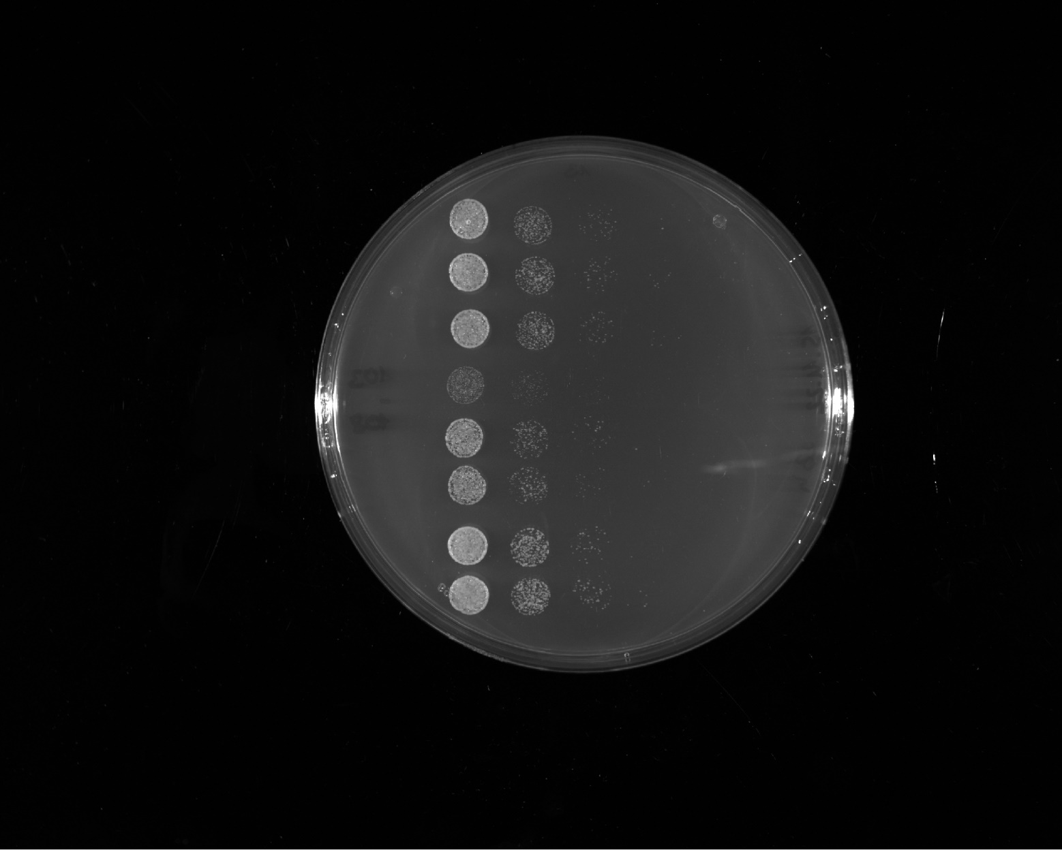
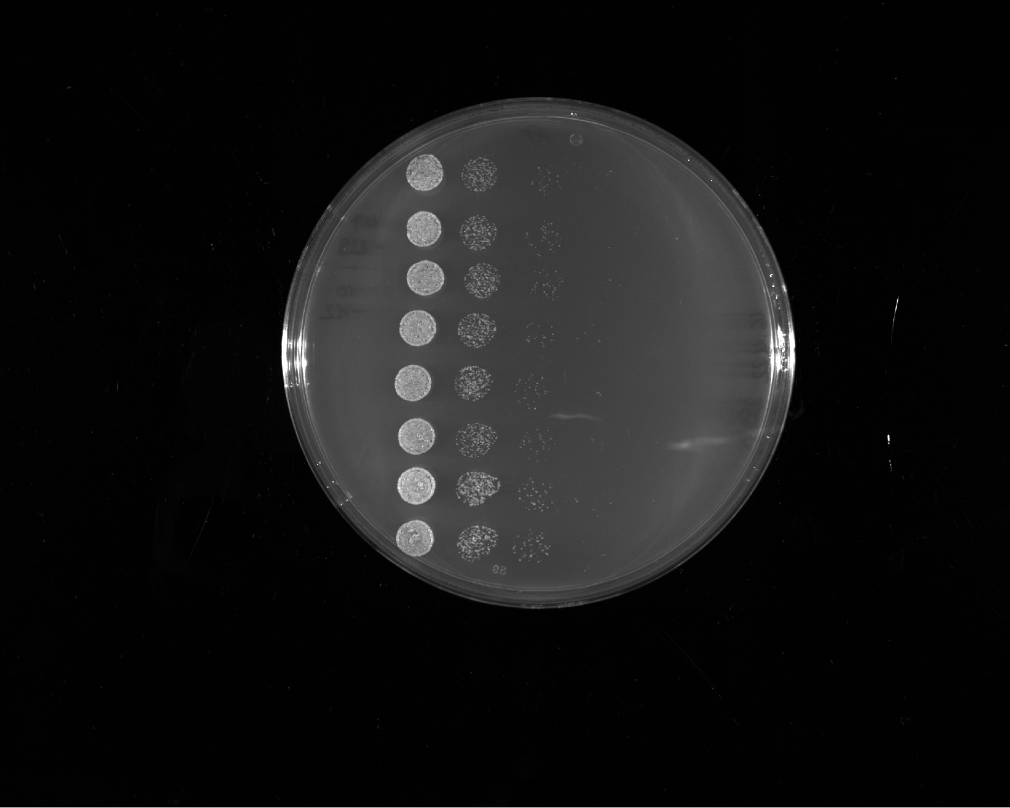
growth rate score
outlier
+++
Reb1¹⁻⁴²⁰
++++
Abf1 WT
++++
LS-1
++++
LS-10
++++
Abf1 WT

Slide 8
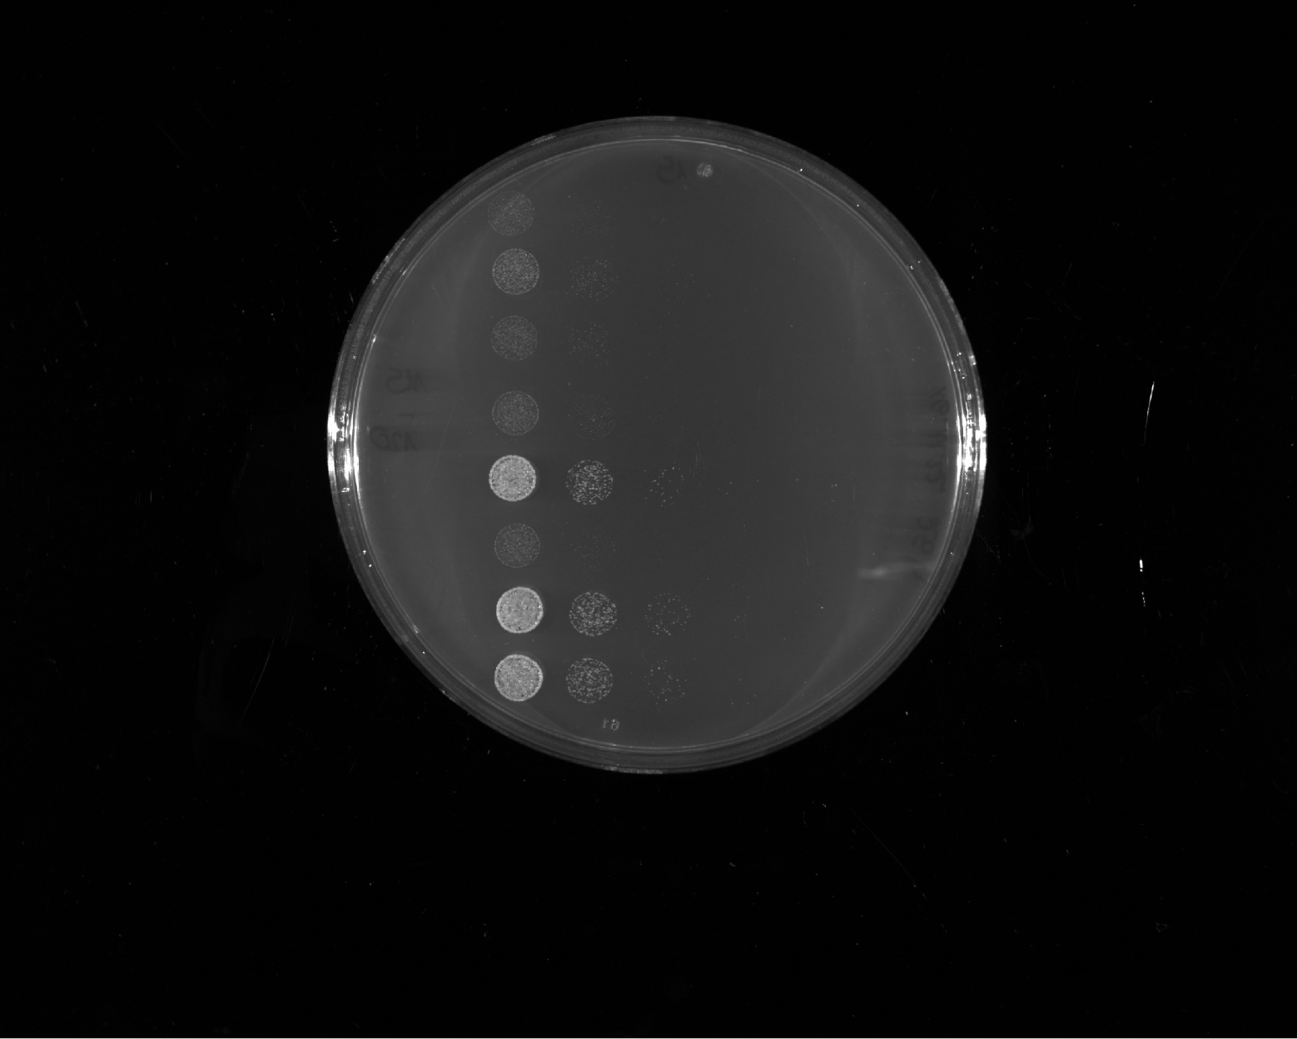
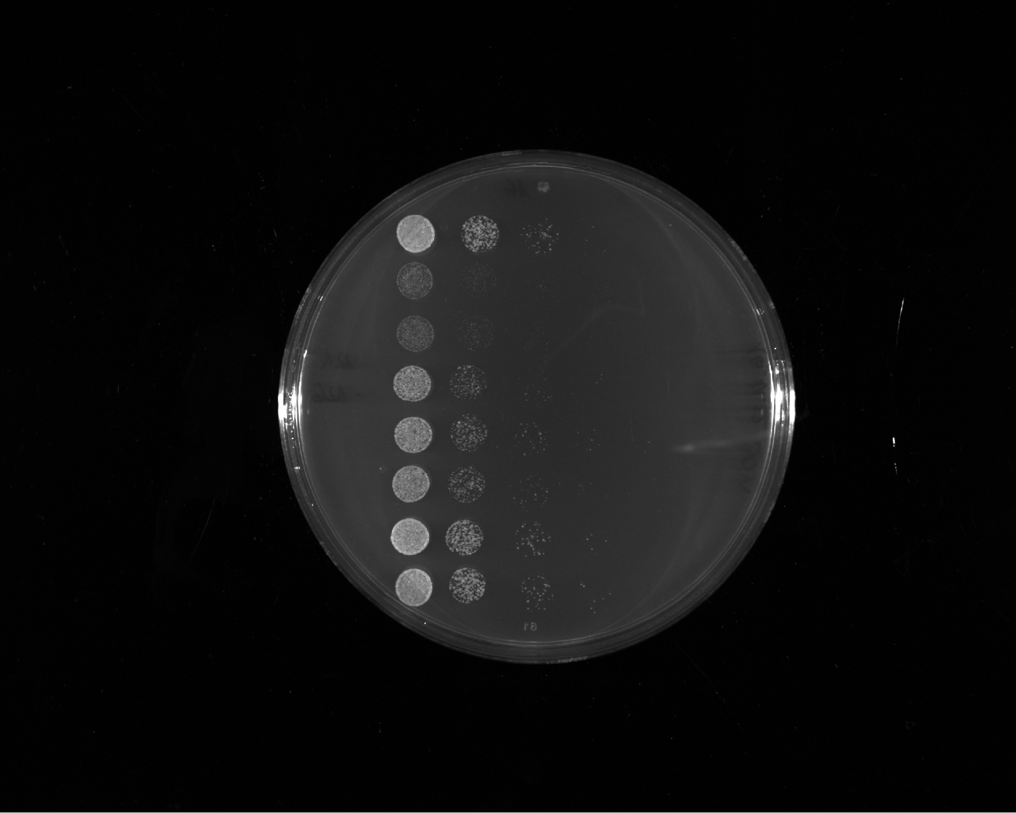
growth rate score
++
K. lactis full length
++
outlier
LS-7
++++
Abf1 WT
outlier
++
ΔIDR1 & IDR2⁴⁴⁹⁻⁶²³
++++
Gal4⁷⁶⁸⁻⁸⁸¹
++++
Abf1 WT

Slide 9
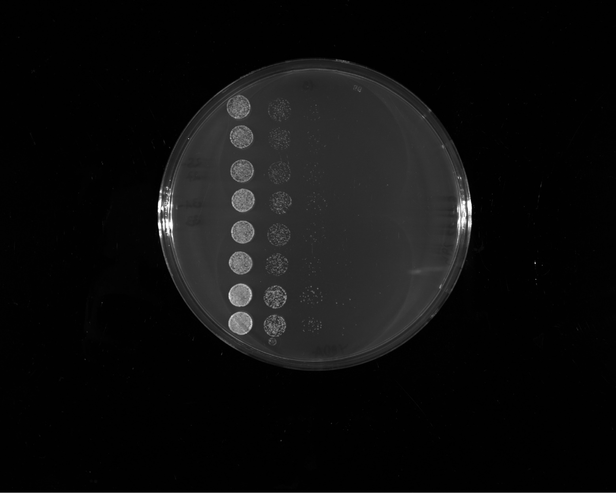
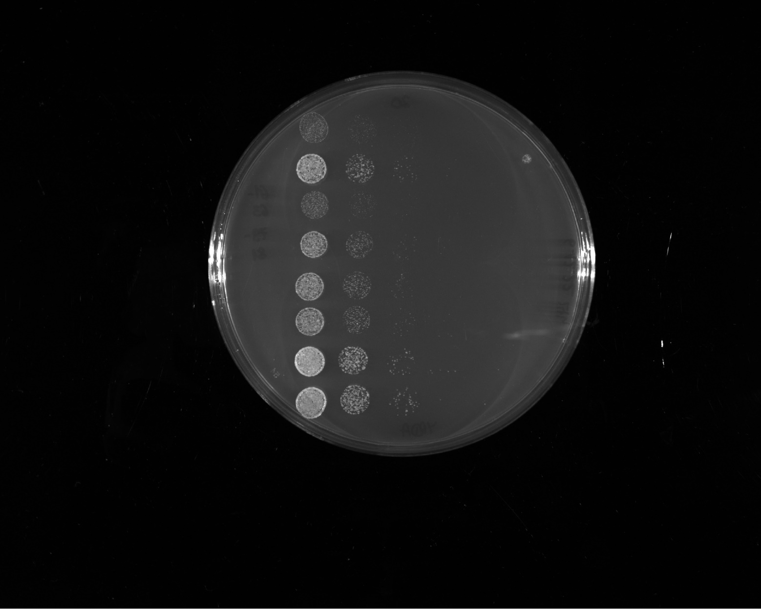
growth rate score
FUS¹⁻¹⁶³12E + Gal4^{G4}
context ΔE/D
+++
+++
FUS¹⁻¹⁶³12E + Gal4^{G4}
motif hydro distr.
++++
Abf1 WT
++
outlier
FUS¹⁻¹⁶³12E + TDP-43
+++
FUS¹⁻¹⁶³12E + Y/M
++++
Abf1 WT

Slide 10
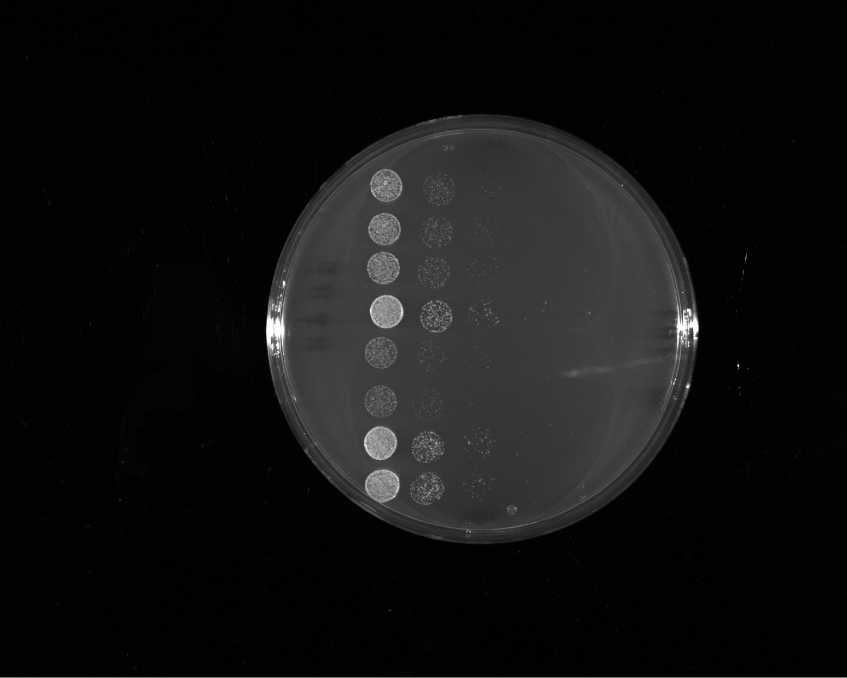
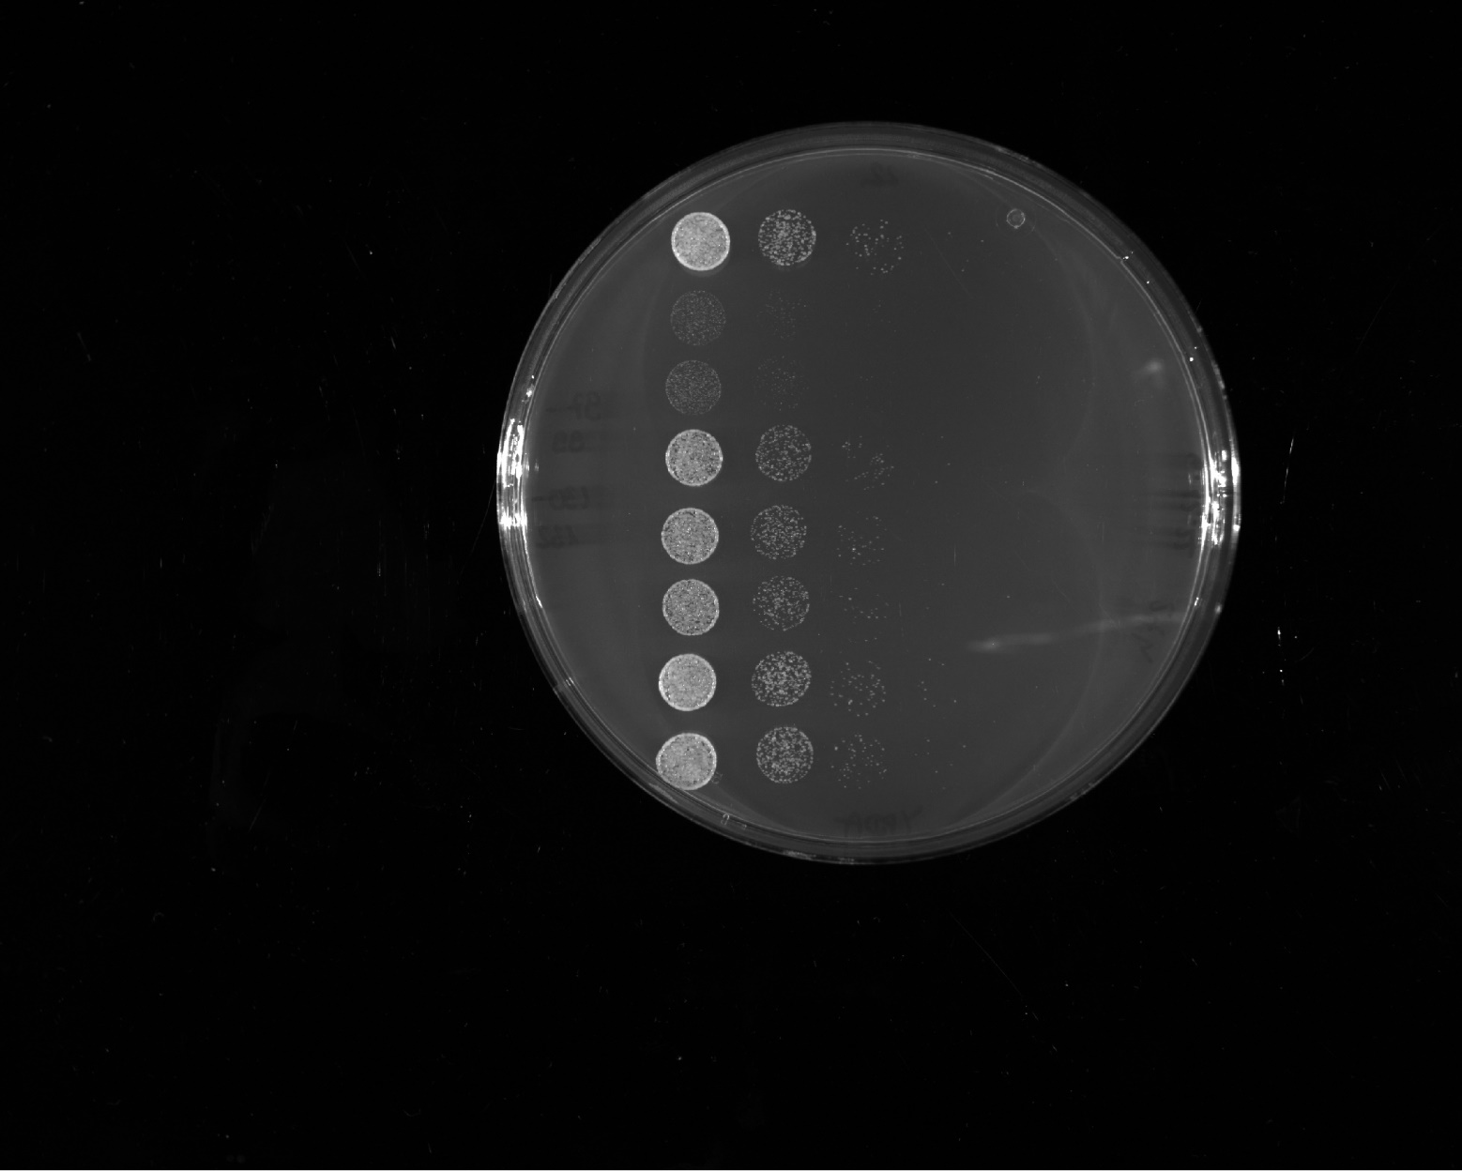
growth rate score
+++
FUS¹⁻¹⁶³12E + GR distr.
outlier
++
Sup35¹⁻¹³¹ + GR
++++
Abf1 WT
outlier
++
Sup35¹⁻¹³¹ + GR distr.
++++
LS-6
++++
Abf1 WT

Slide 11
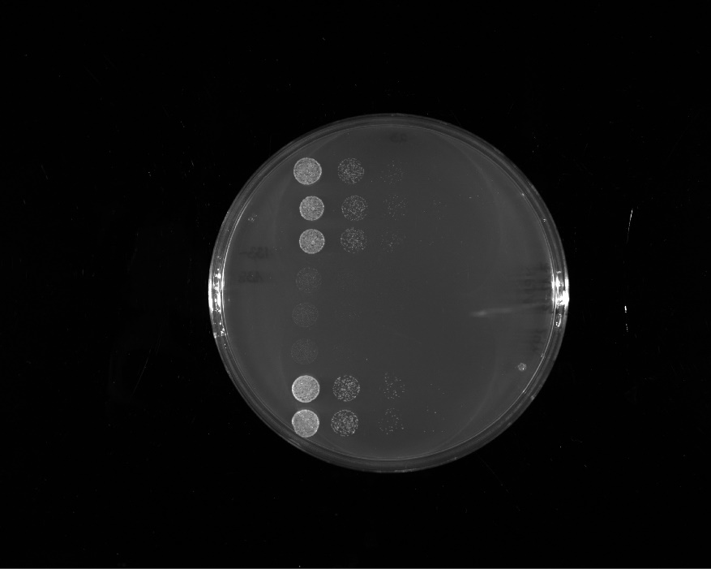
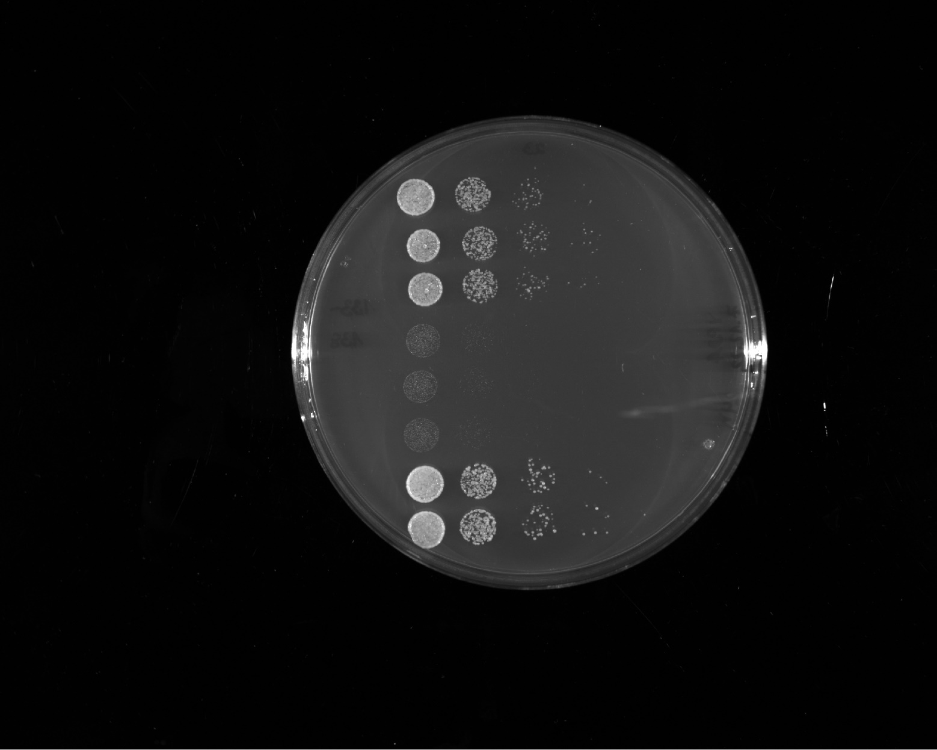
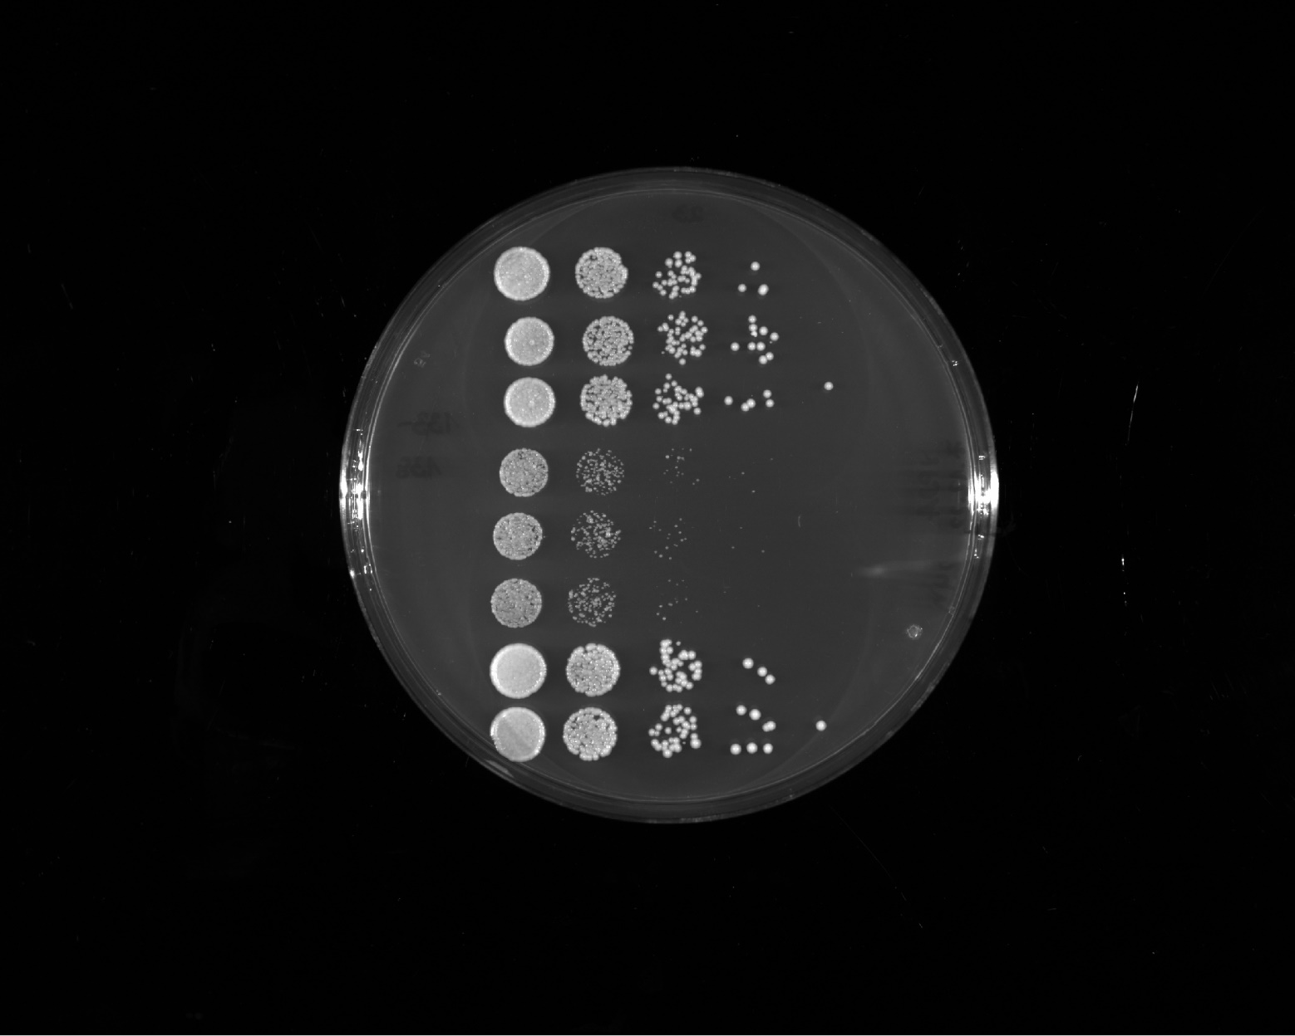
growth rate score
1 day
++++
Pho4¹⁻²⁴⁹
+
LS-15
++++
Abf1 WT
2 days
3 days

Slide 12
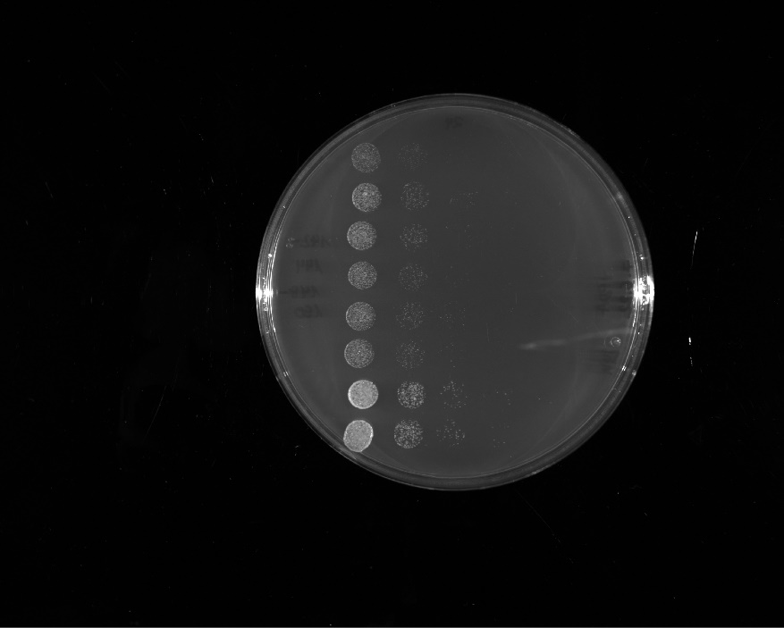
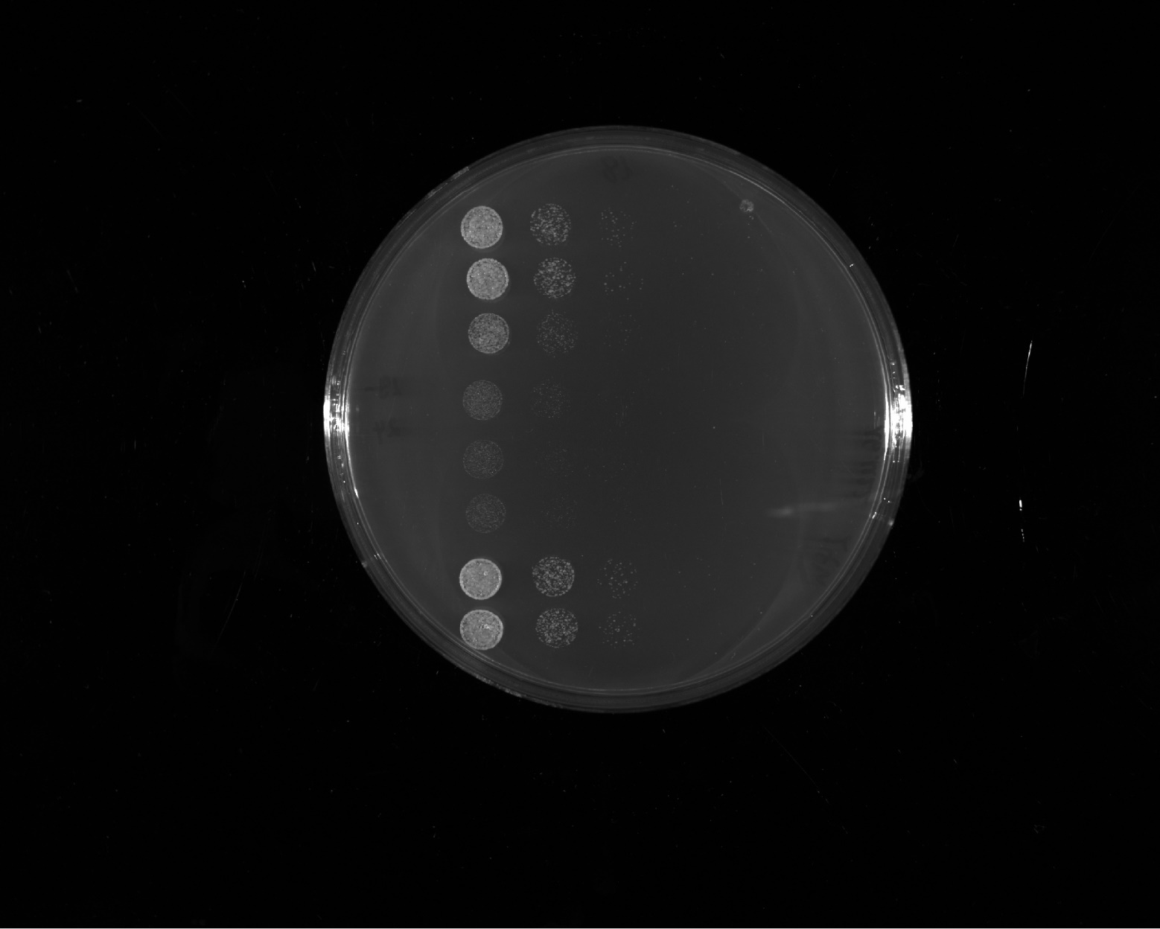
growth rate score
+++
Altered valence 2
+++
TDP-43 distr.
++++
Abf1 WT
++
FUS¹⁻¹⁶³12E + Abf1^{G4}
++++
Abf1 WT

Slide 13
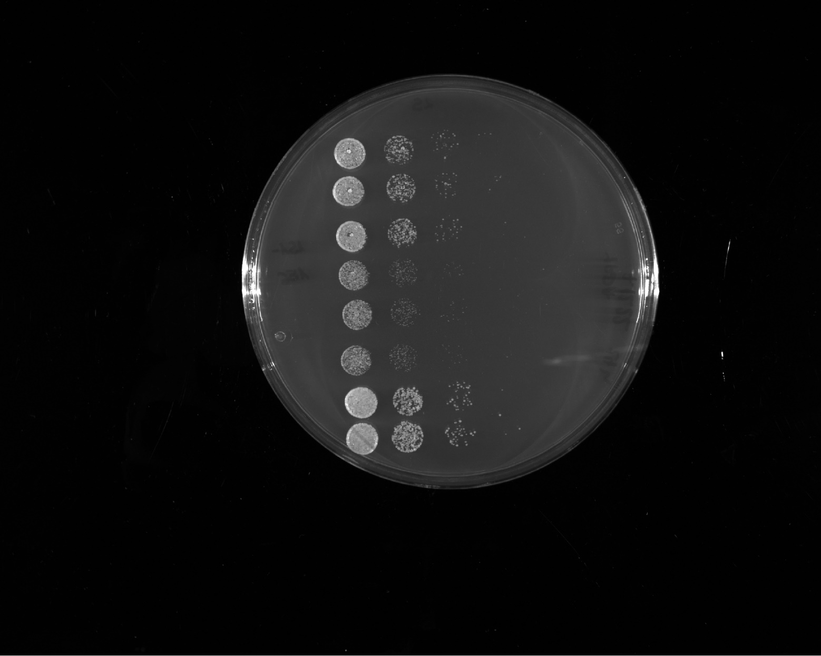
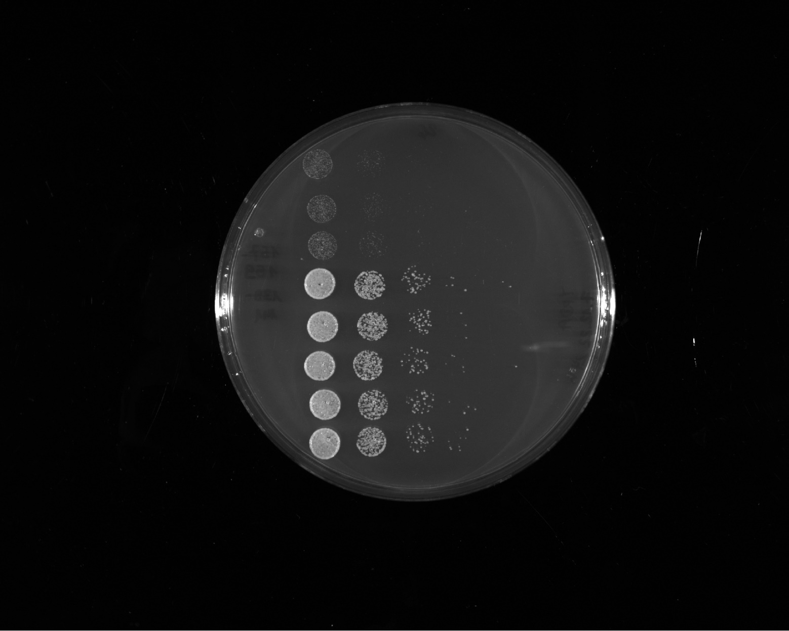
growth rate score
++++
Gal4⁷⁶⁸⁻⁸⁸¹ shuffle 1
+++
Gal4⁷⁶⁸⁻⁸⁸¹ shuffle 2
++++
Abf1 WT
++
Gal4⁷⁶⁸⁻⁸⁸¹ shuffle 3
++++
Abf1 WT

Slide 14
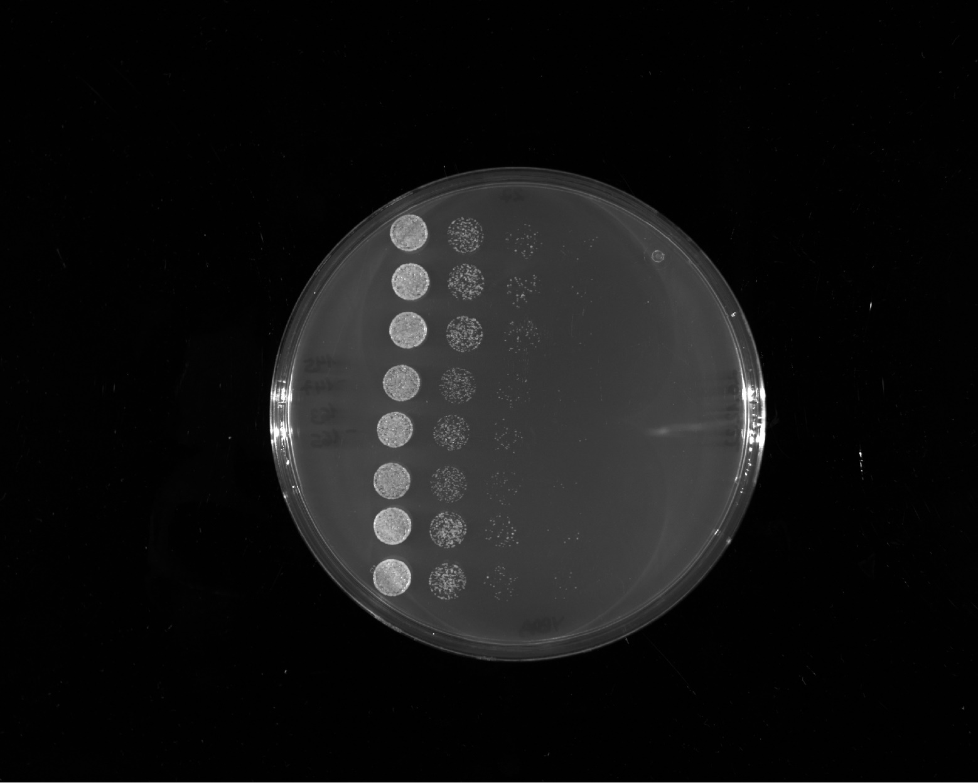
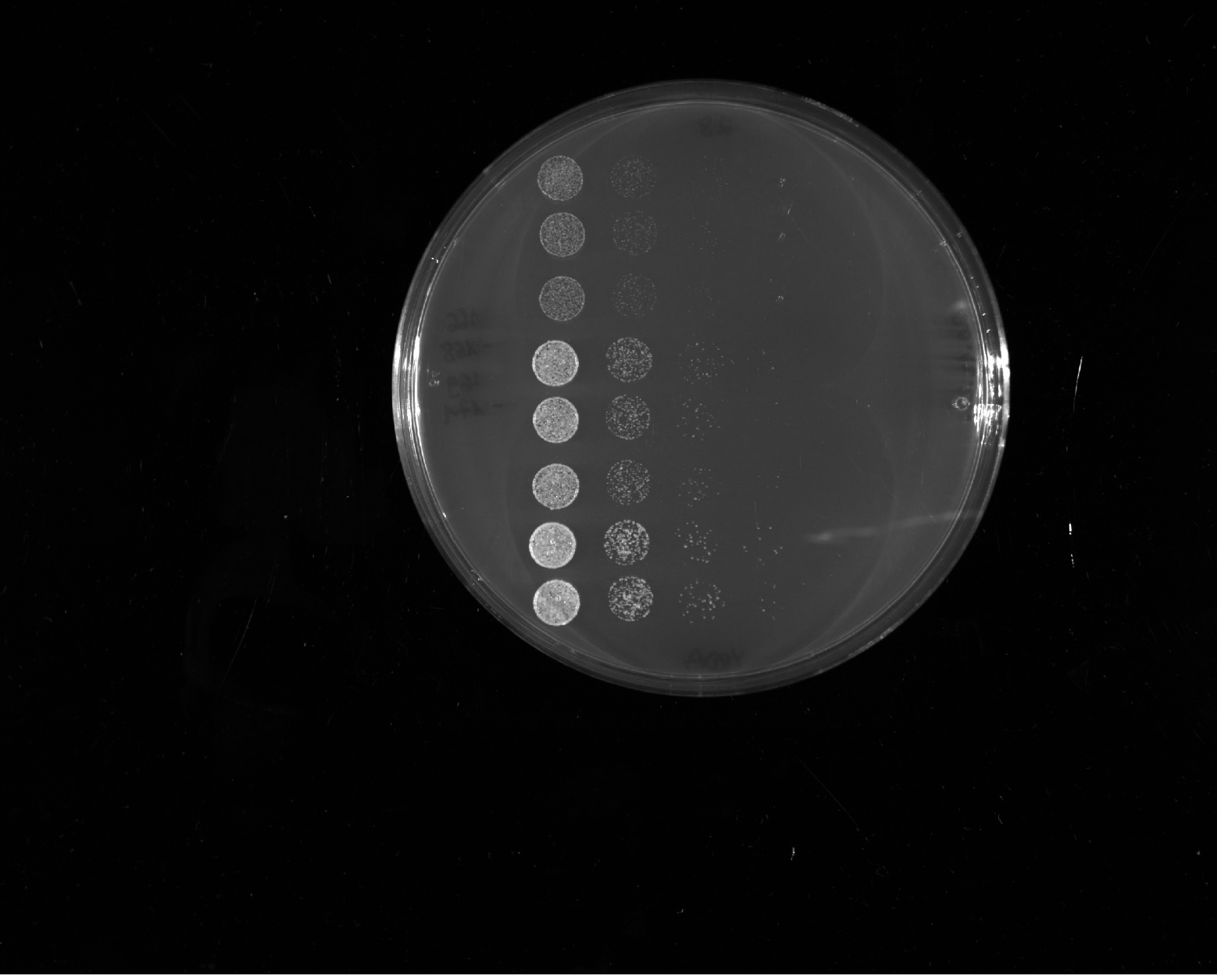
growth rate score
++++
ΔIDR1
++++
ΔIDR1 & IDR2⁴⁴⁹⁻⁶⁶²
++++
Abf1 WT
+++
FUS¹⁻¹⁶³12E + Gal4^{G4}
++++
Altered valence 1
++++
Abf1 WT

Slide 15
growth rate score
1 day
+
FUS¹⁻¹⁶³12E + Gal4^{G4}
all ΔE/D
+
NCS-506-Flag
++++
Abf1 WT
2 days
FUS¹⁻¹⁶³12E + Gal4^{G4}
all ΔE/D
NCS-506-Flag
Abf1 WT

Slide 16
growth rate score
1 day
++
NCS-508
+
NCS-17
outlier
++++
Abf1 WT
2 days
NCS-508
NCS-17
outlier
Abf1 WT

Slide 17
growth rate score
+++
NCS-3
+++
NCS-504
++++
Abf1 WT
+++
NCS-1010
+++
NCS-1502
++++
Abf1 WT

Slide 18
growth rate score
+++
NCS-1508
++++
outlier
NCS-509
++++
Abf1 WT
outlier
++++
NCS-510
+++
NCS-21
++++
Abf1 WT

Slide 19
growth rate score
1 day
++
NCS-38
(not part of this study)
+
NCS-44
++++
Abf1 WT
2 days
NCS-38
(not part of this study)
NCS-44
Abf1 WT

Slide 20
growth rate score
++
Sup35¹⁻¹³¹ + p65 distr.
(not part of this study)
++++
Abf1 WT
+++
FUS¹⁻¹⁶³12E + EM
++++
Abf1 WT
+++
FUS¹⁻¹⁶³12E + Gal4^{G4} shuffle
++++
Abf1 WT

Slide 21
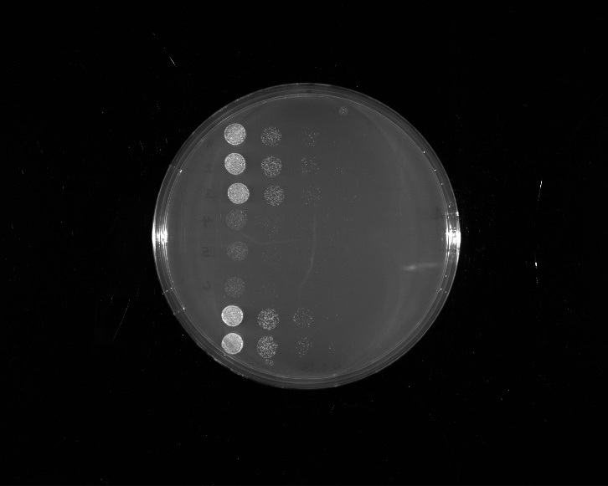
growth rate score
not part of this study
++
Sup35¹⁻¹³¹ + EM
++++
Abf1 WT
++++
FUS¹⁻¹⁶³12E + Gal4^{G4} distr. II
++++
Abf1 WT

Slide 22
growth rate score
1 day
+
NCS-21 hydro→polar
++++
Abf1 WT
2 days
+
NCS-21 hydro→polar
++++
Abf1 WT

